Slide 1
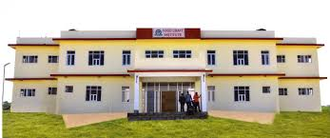
FOOD CRAFT INSTITUTE SUMERPUR (PALI)

Slide 2
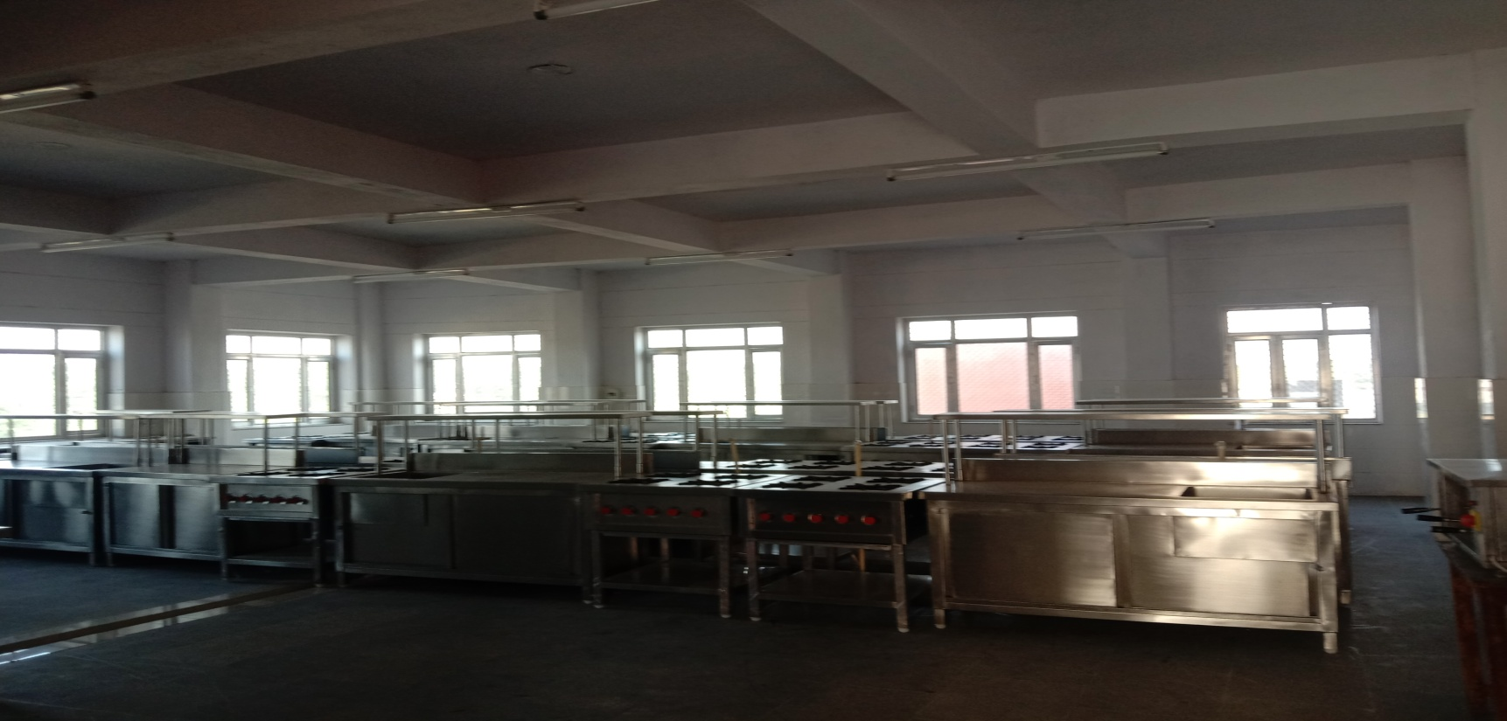
BUILDING INFRASTRUCTURE
Basic Training Kitchen

Slide 3
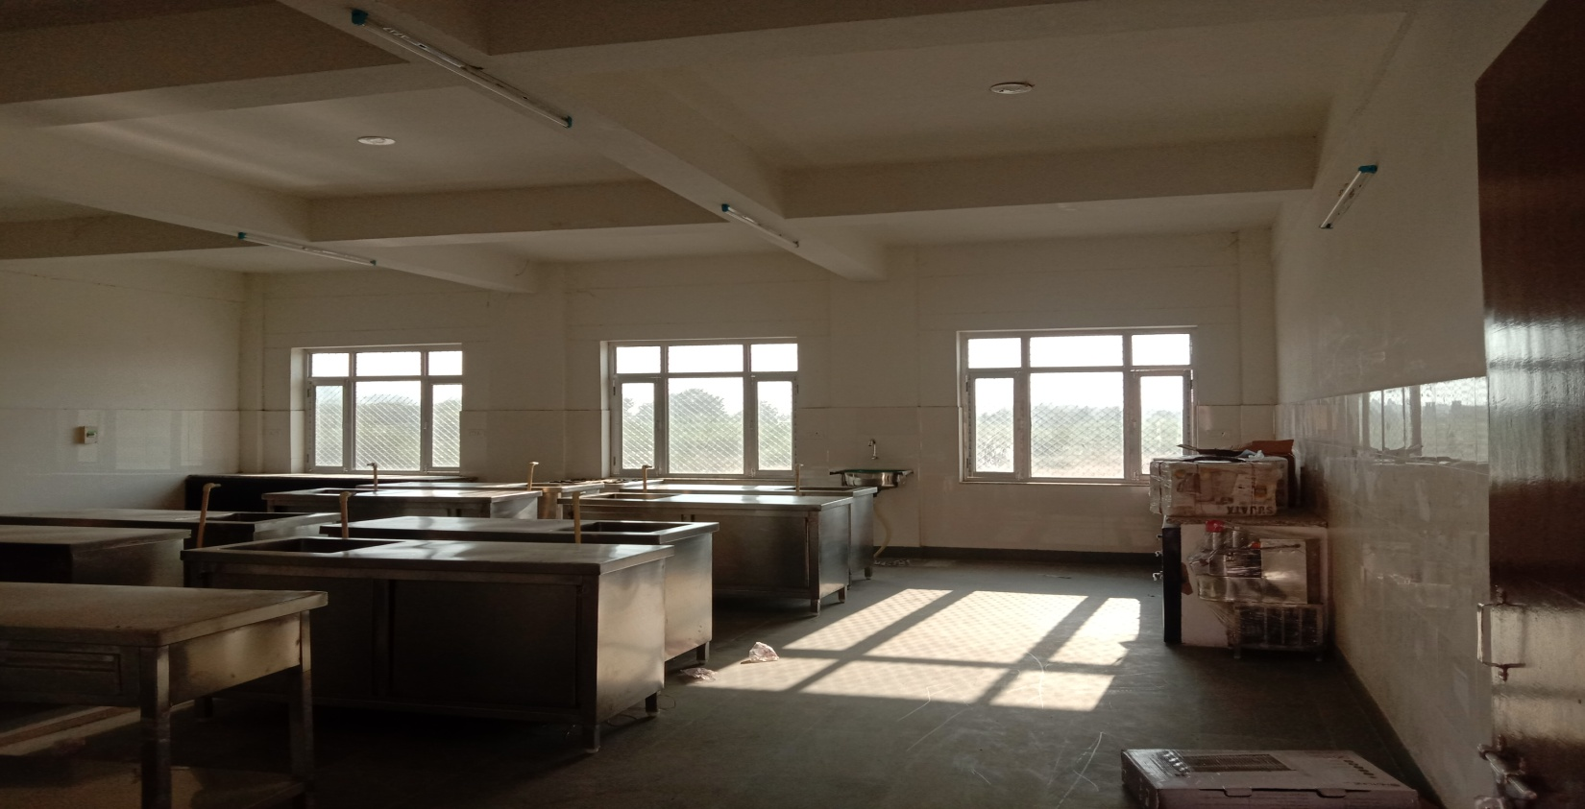
LARDER
Basic Training Kitchen

Slide 4
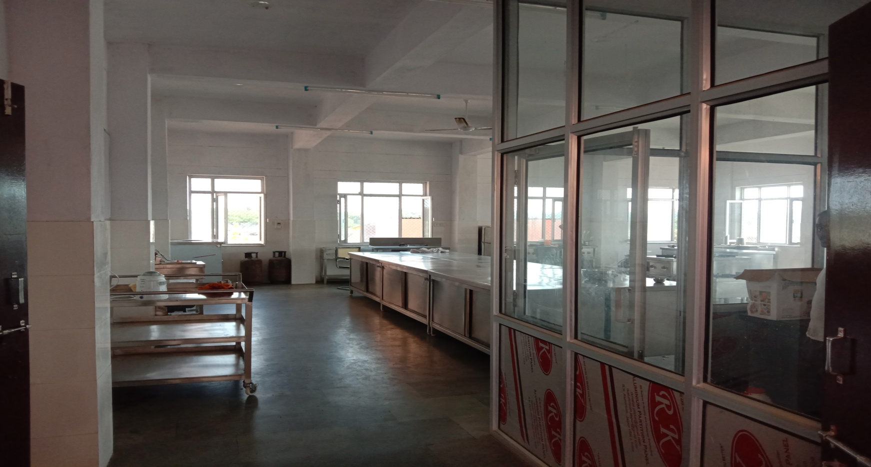
Quantity Food Kitchen

Slide 5
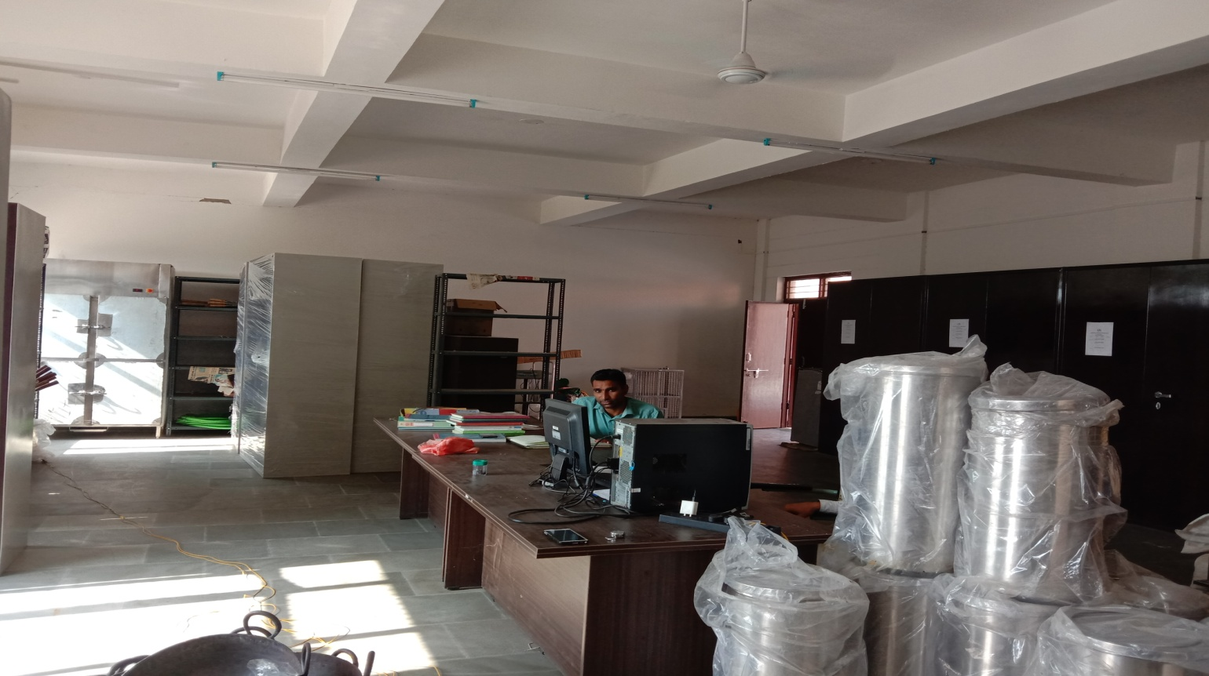
Cold & Dry Food Store

Slide 6
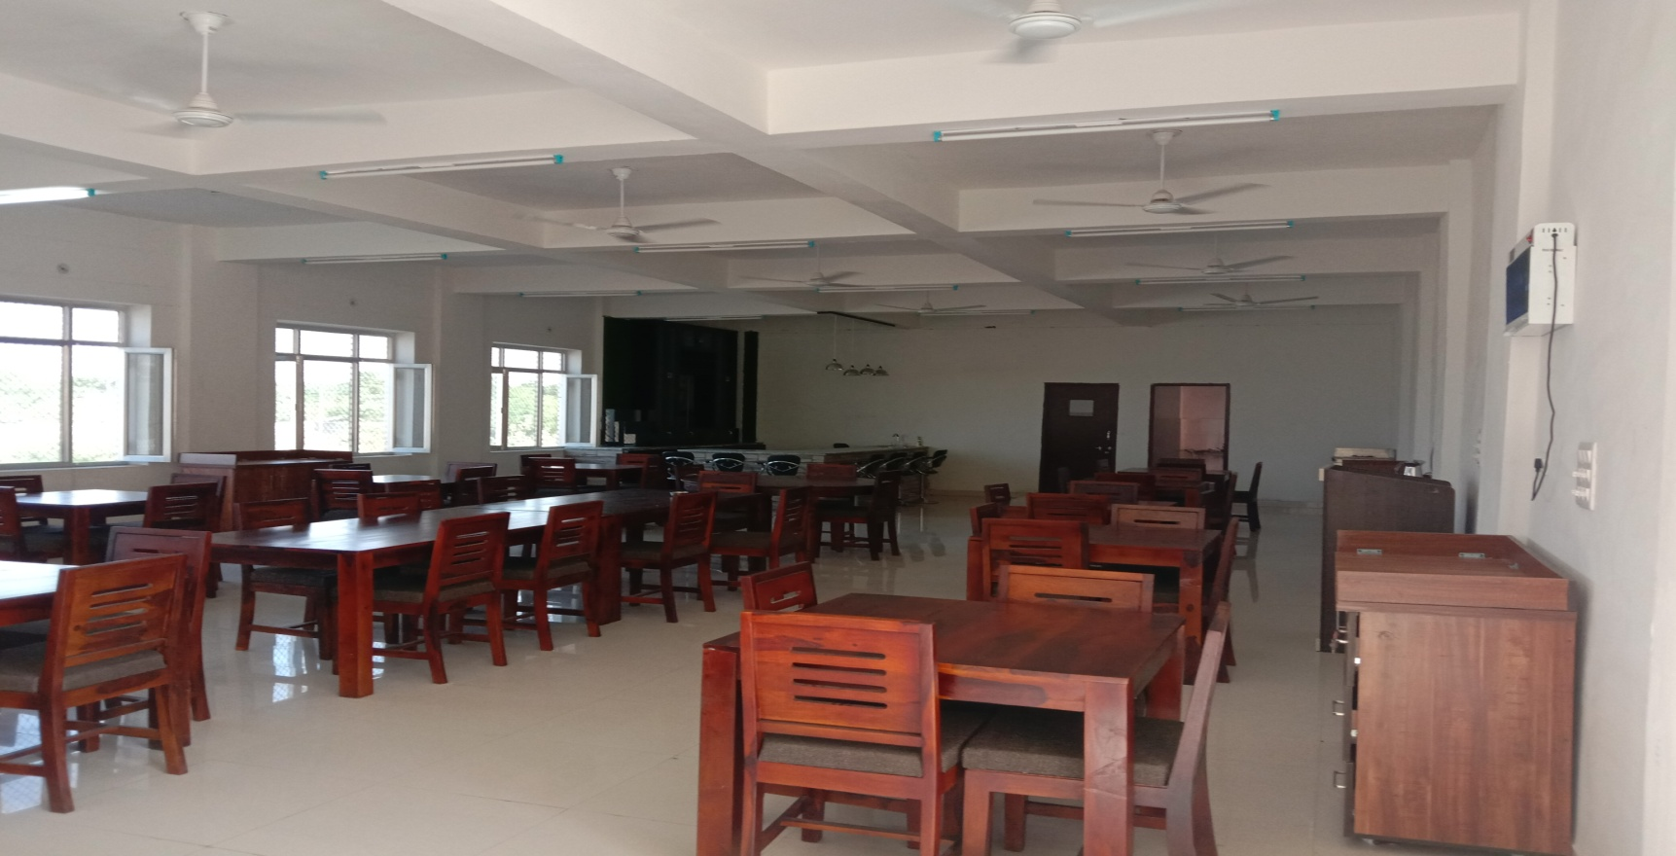
Basic Training Restaurant & Pantry

Slide 7
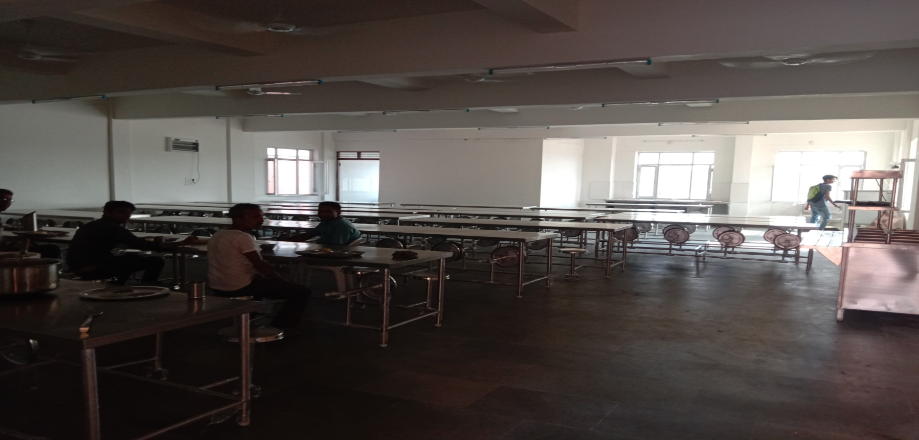
Students Dining Hall + Pantry

Slide 8
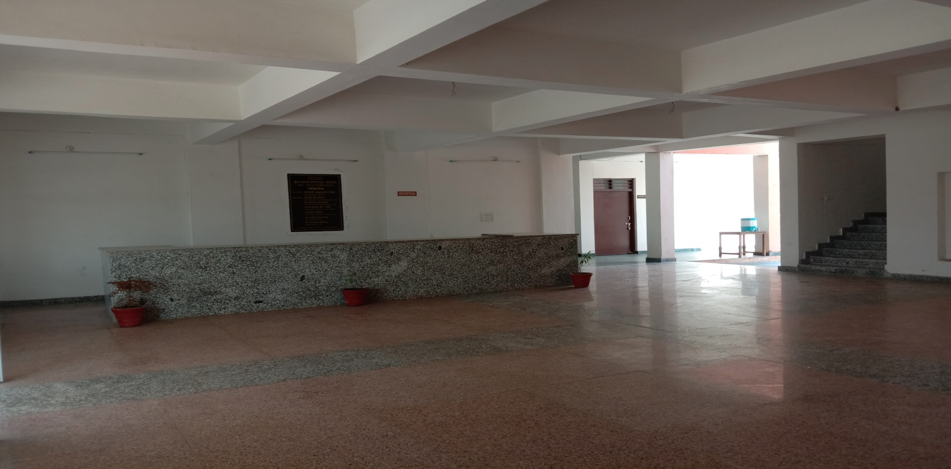
Front Office Lab

Slide 9
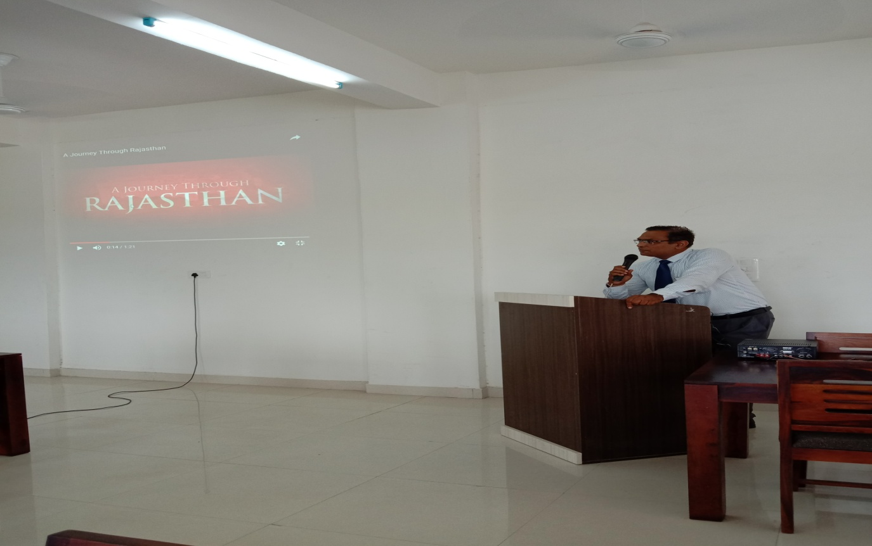
Conference Room

Slide 10
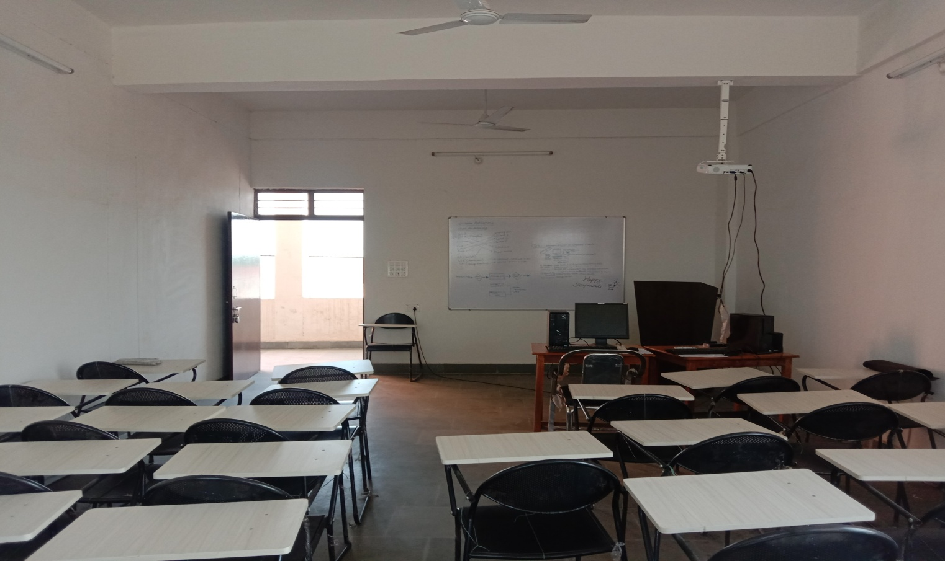
Total 4 Classrooms

Slide 11
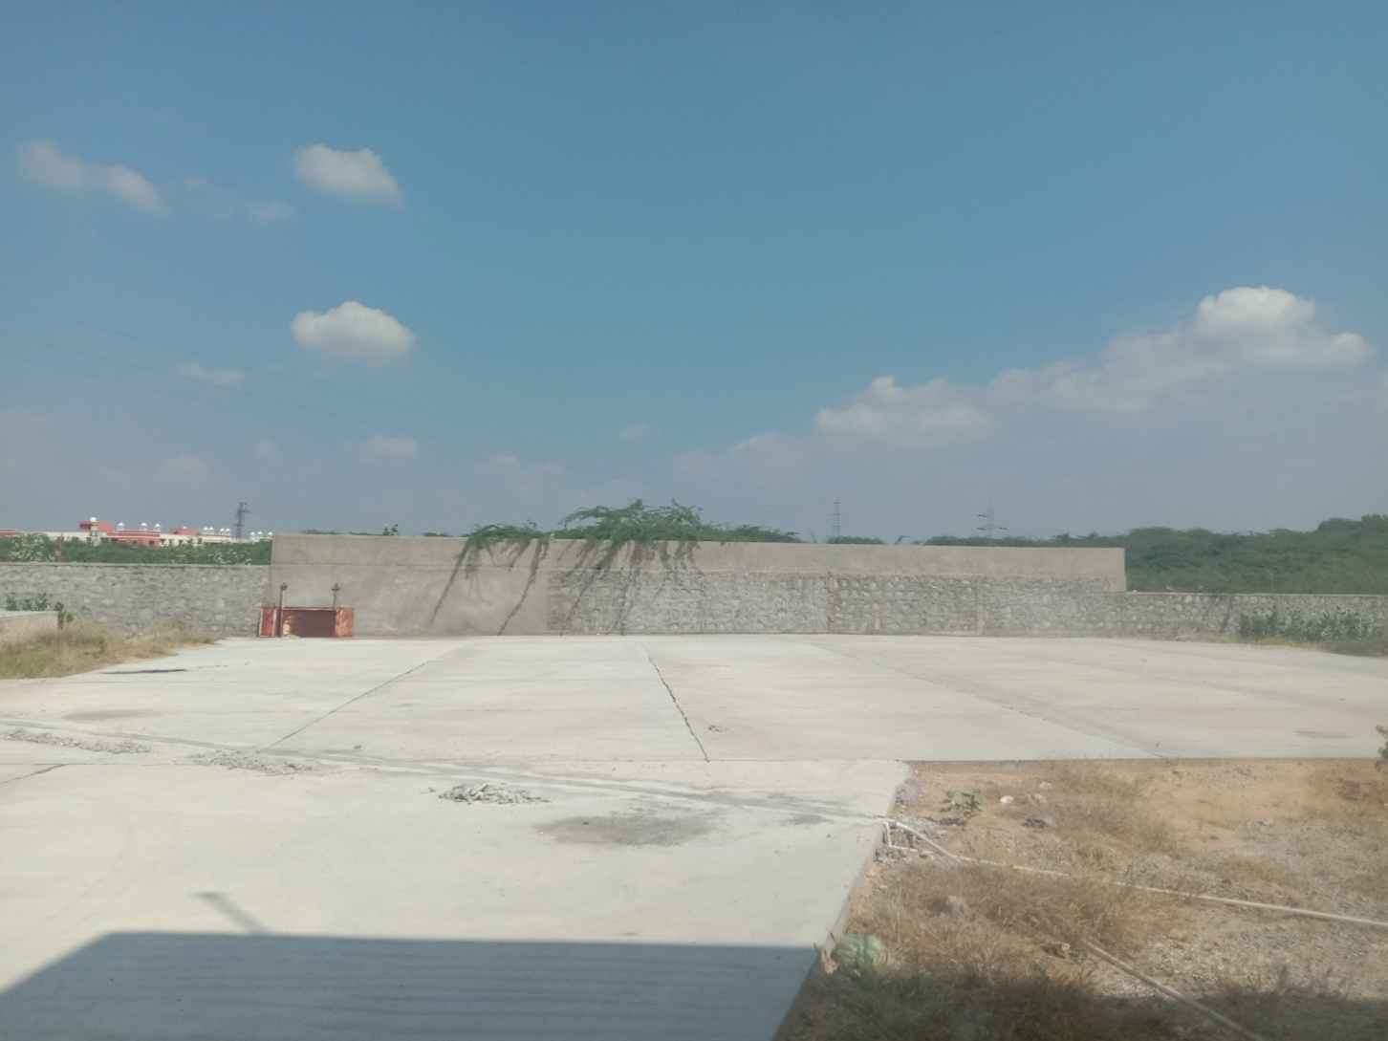
Cemented Parking Area

Slide 12
Supporting Infrastructure in place
Sanctioned Electricity Load of 125 KV from RSEB
Stand-by Generator, 125 KV
Underground water storage tank 20 KL capacity
Configuration of Gas Bank

Slide 13
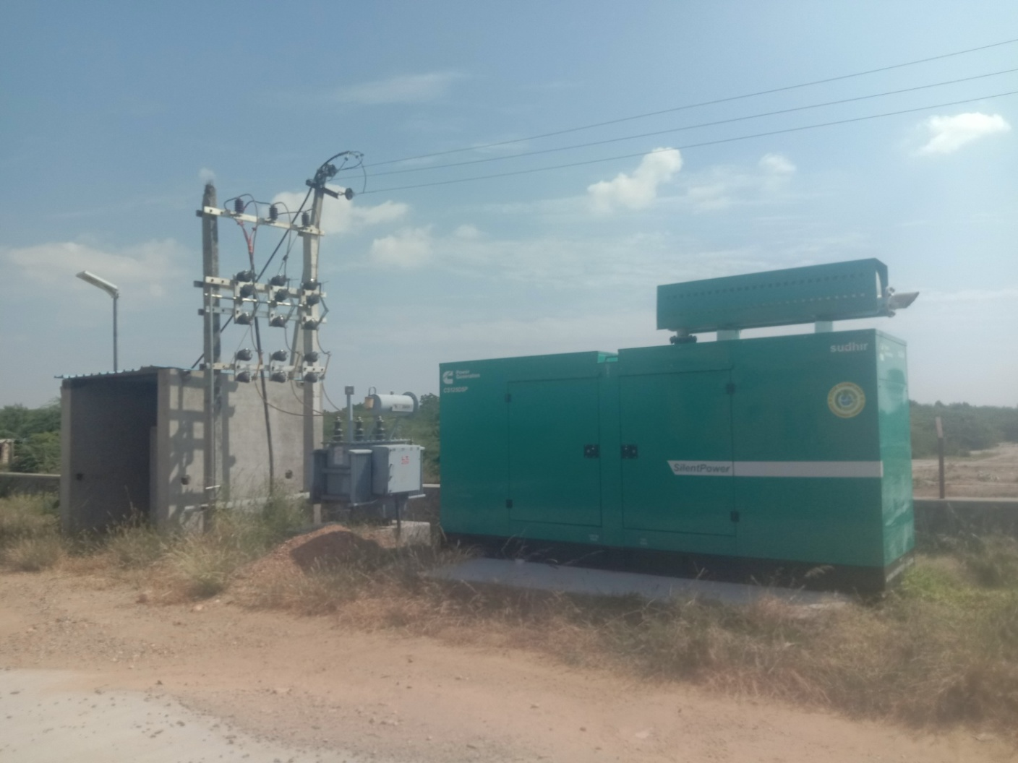
Transformer-gen set

Slide 14
Future Upcoming Facilities
Free Wi-fi in campus
Hostel and Mess facility for outstation candidates
Playground development
Improved road connectivity
Future upgradation to degree college

Slide 15
Programs offered by Institute
Diploma in Food Production (1-1/2 year) (Affiliated to National Council For Hotel Mgt., Noida)
Eligibility – 12th Pass (Art/Commerce/ Science)
Age: 18-25 years
Advantage - Course can be done along with Regular Graduation.
Career Options: Chef/cook in Hotels, Restaurant, Cruise, Railways, Foreign Countries, Catering business

Slide 16
Programs offered by Institute
Diploma in Food and Beverage Service (1-1/2 year) (Affiliated to National Council For Hotel Mgt., Noida)
Eligibility – 12th Pass (Art/Commerce/ Science)
Age: 18-25 years
Advantage - Course can be done along with Regular Graduation.
Career Options: Flight steward, Captain/Manager in Restaurant, Bar, Cruise, Foreign Countries, Catering business, Banqueting

Slide 17
Programs offered by Institute
Diploma in Front Office (1-1/2 year) (Affiliated to National Council For Hotel Mgt., Noida)
Eligibility – 12th Pass (Art/Commerce/ Science)
Age: 18-25 years
Advantage - Course can be done along with Regular Graduation.
Career Options: Receptionist, Front Desk Executive, Lobby Manager, Event Management, Sales & Marketing, Call center, Customer care

Slide 18
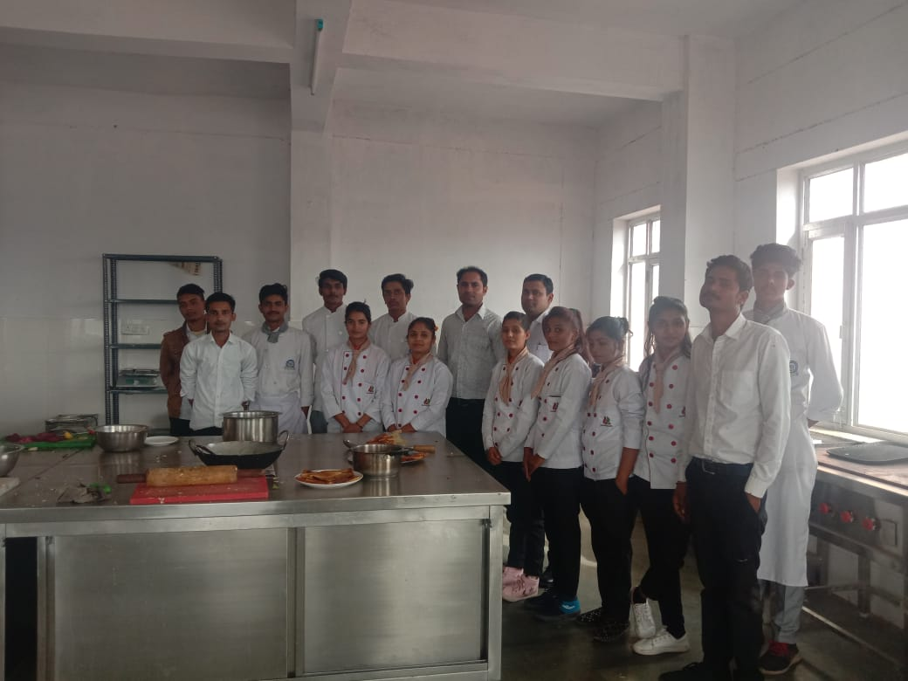
Students in Kitchen - Chefs of the future

Slide 19
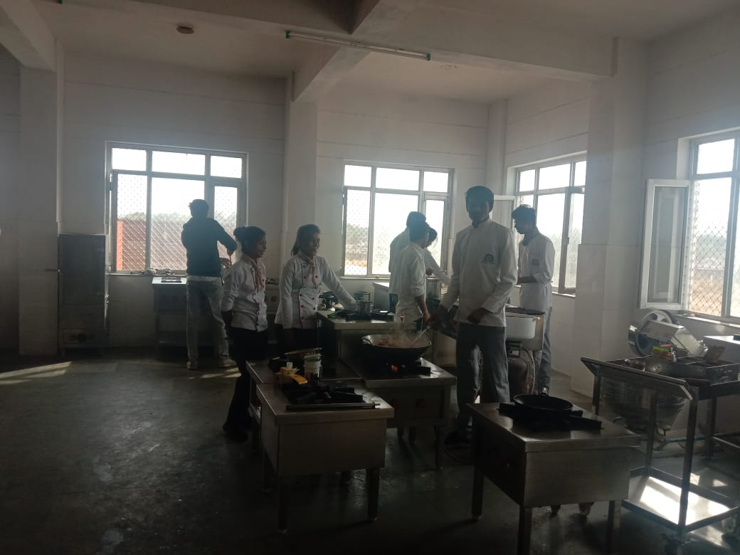
Students Preparing Dishes

Slide 20
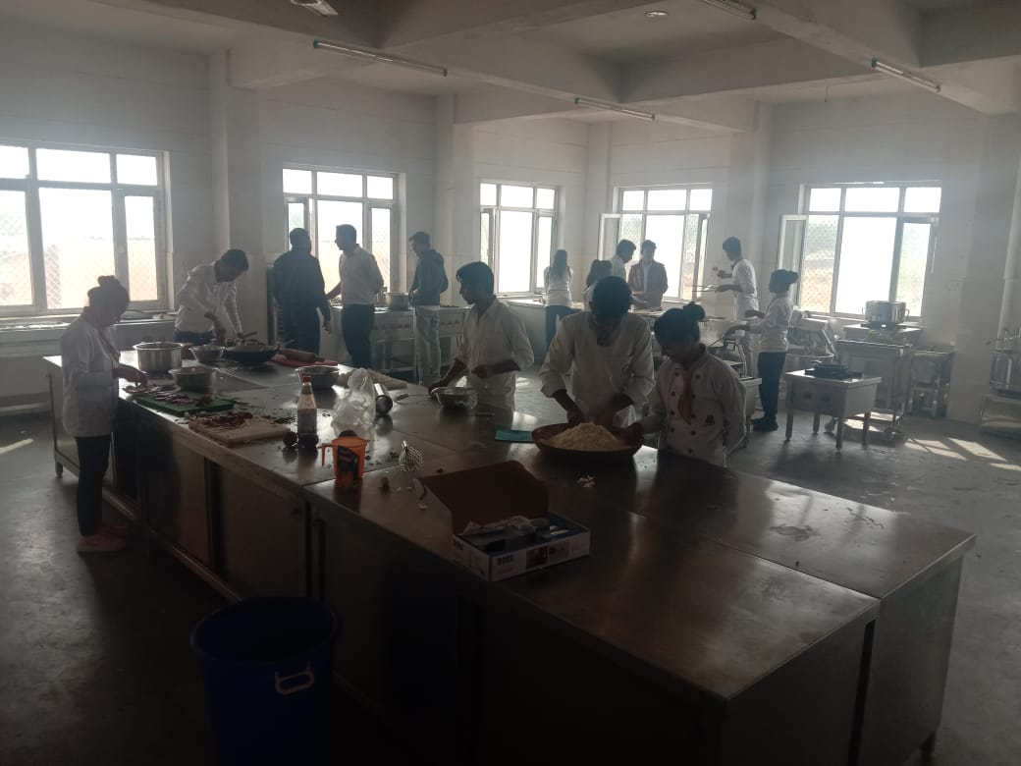
Students Doing Practical Work

Slide 21
Thank You

